Slide 1

DECISION TREE

Slide 2

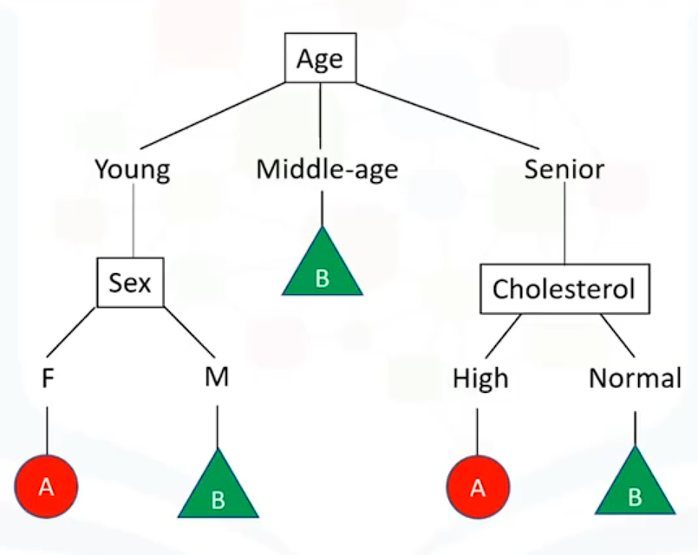
WHAT IS DECISION TREE ?
Decision tree algorithm falls under the category of supervised learning.
Decision tree uses the tree representation to solve the problem in which each leaf node corresponds to a class label and attributes are represented on the internal node of the tree.
We can represent any Boolean function on discrete attributes using the decision tree.

Slide 3
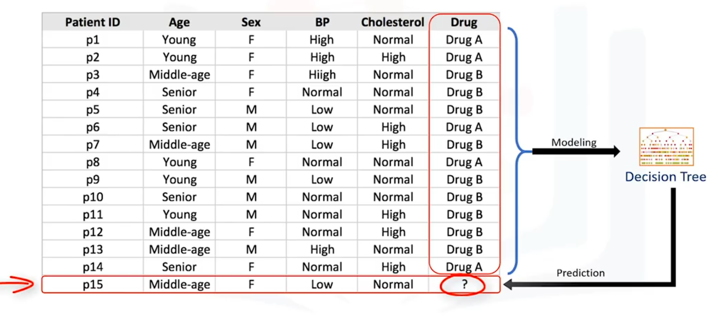
HOW TO BUILD DECISION TREE ?

Slide 4
DECISION TREE LEARNING ALGORITHM
Choose an attribute from your dataset .
Calculate the significance of attribute in splitting of data.
Split data based on the value of the best attribute.
Go to step 1.

Slide 5
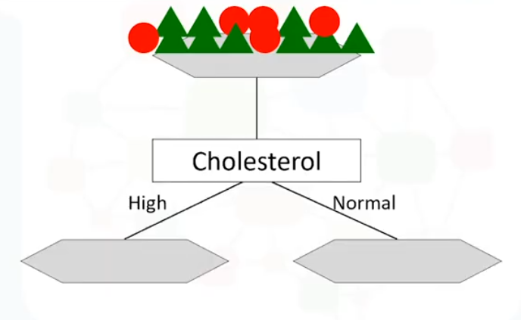
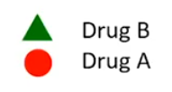
WHICH ATTRIBUTE IS THE BEST ?

Slide 6
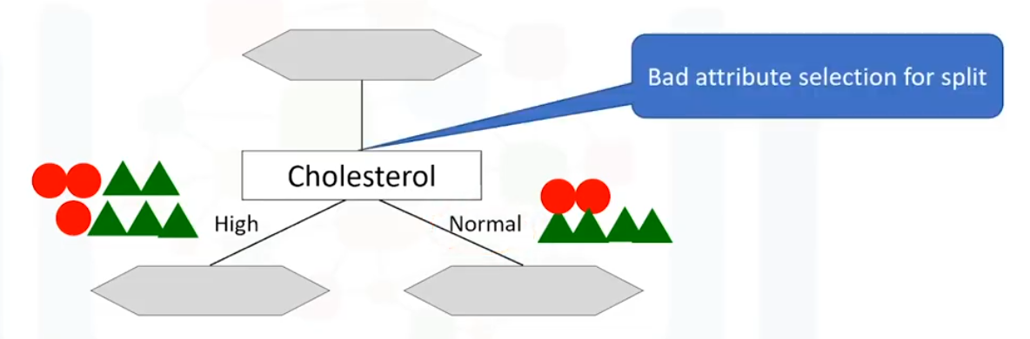
WHICH ATTRIBUTE IS THE BEST ?

Slide 7
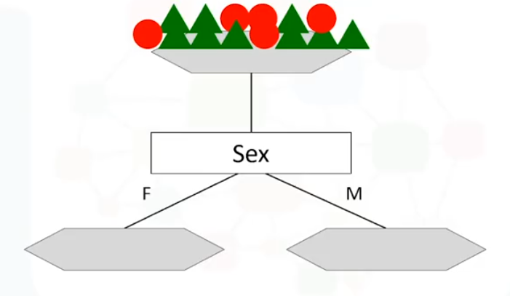
WHICH ATTRIBUTE IS THE BEST ?

Slide 8
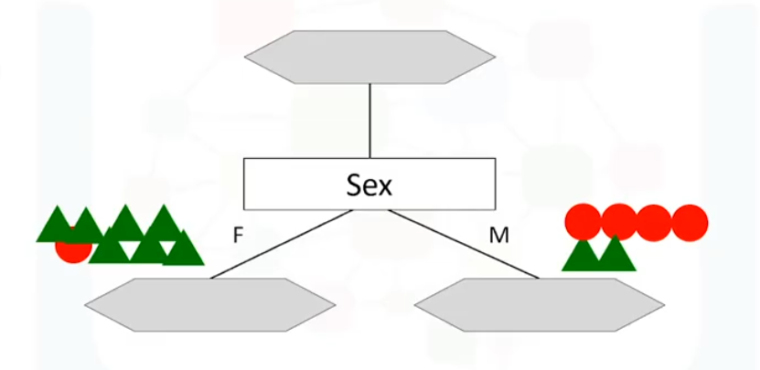
WHICH ATTRIBUTE IS THE BEST ?
More Predictiveness
Low Impurity
Lower Entropy

Slide 9

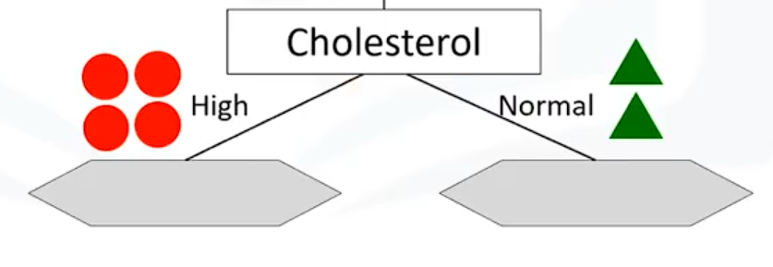
WHICH ATTRIBUTE IS THE BEST ?
More Predictiveness
Low Impurity
Lower Entropy

Slide 10
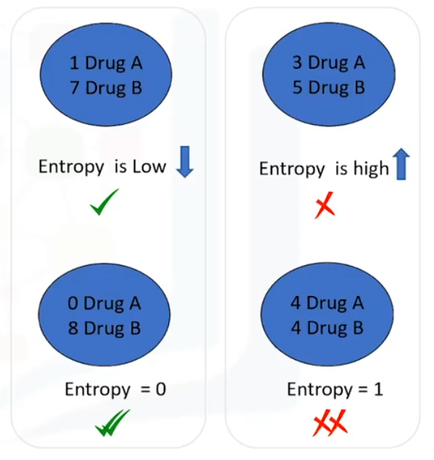
Entropy
Entropy is the measure of uncertainty of a random variable, it characterizes the impurity of an arbitrary collection of examples.
The higher the entropy more the information content.
The Lower the Entropy, the less uniform the distribution, the pure the nodes.

Slide 11
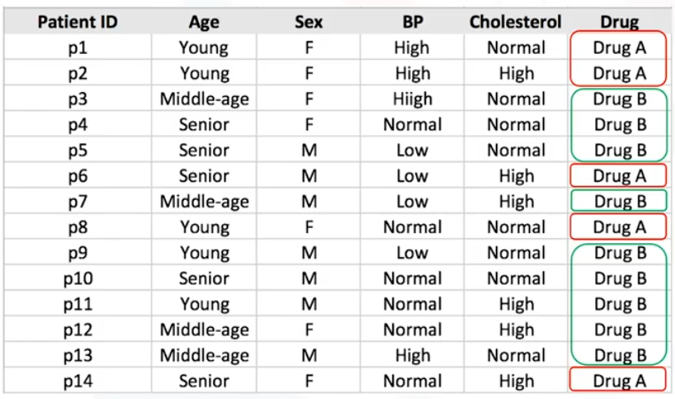
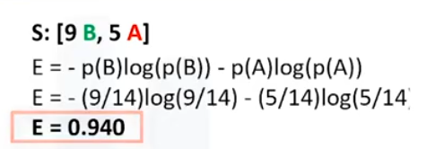
Which attribute is best one to use ?

Slide 12
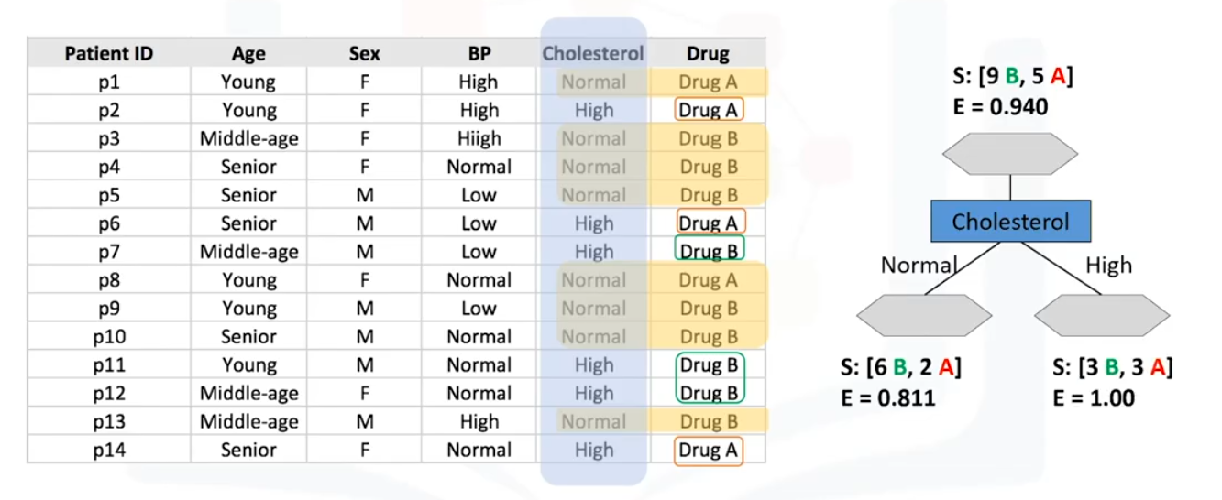
Is ‘Cholesterol’ the best attribute ?

Slide 13
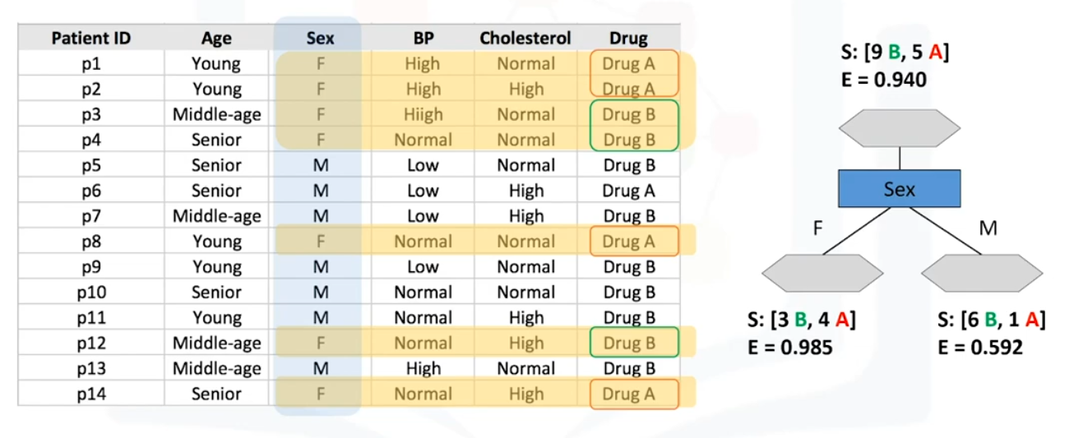
Is ‘Sex’ the best attribute ?

Slide 14
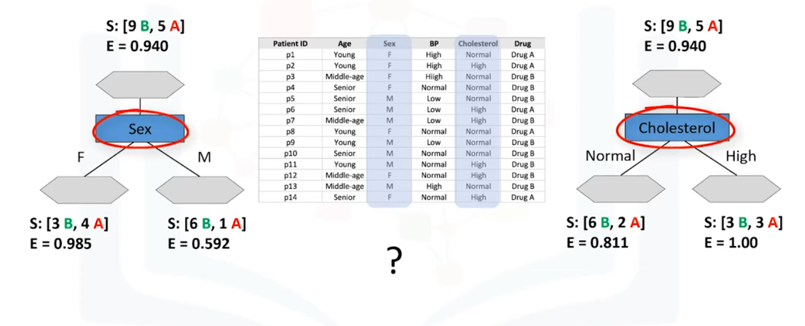
Which attribute is the best ?

Slide 15
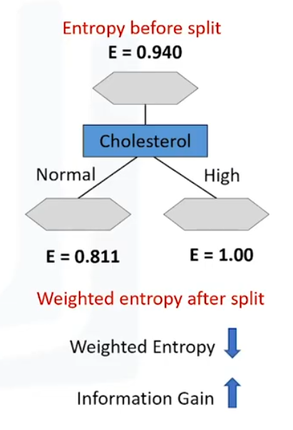
What is Information gain ?
When we use a node in a decision tree to partition the training instances into smaller subsets the entropy changes.
Information gain is a measure of this changes in entropy.

Slide 16
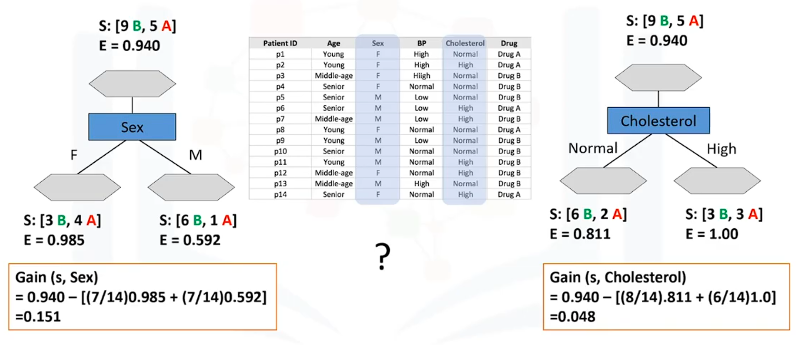
Which attribute is best?

Slide 17
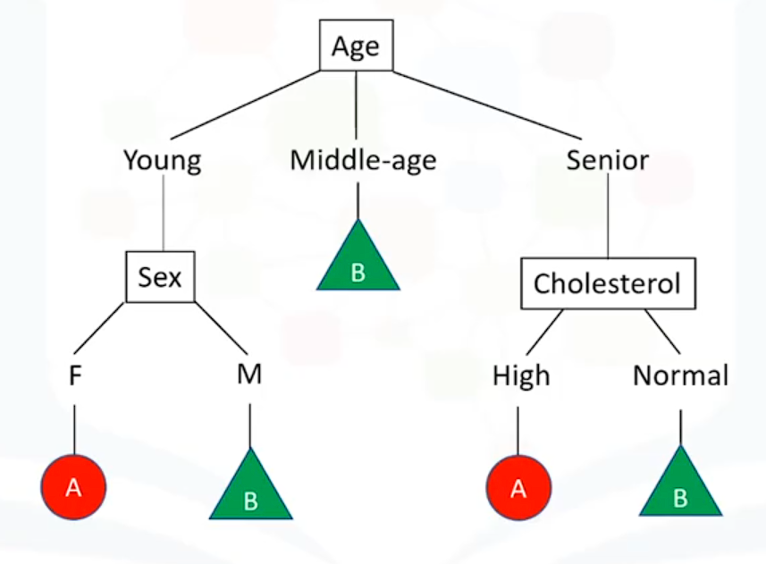
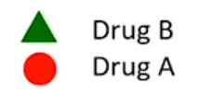
Decision tree with the training Set

